Slide 1
GODEX
Data Exchange Meeting (Lannion 2017)
Deutscher Wetterdienst (DWD) status report
Alexander Cress
Deutscher Wetterdienst, Frankfurter Strasse 135, 6003 Offenbach am Main, Germany
alexander.cress@dwd.de
and Robin Faulwetter, Olaf Stiller, Anne Walter, Stefanie Holbrook, Michael Bender.
Andreas Rhodin, Harald Anlauf, Christina Köpken-Watts, Kirstin Raykova, Axel Hutt etc…
GODEX Meeting Alexander Cress Lannion 2017

Slide 2
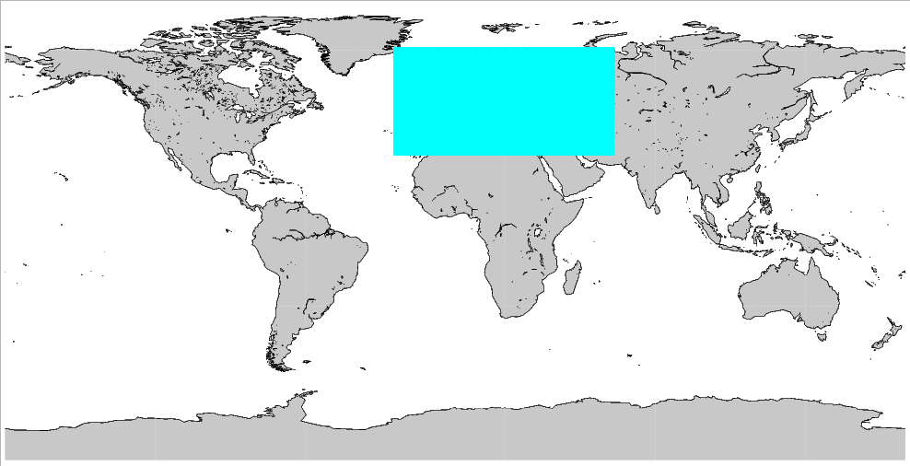
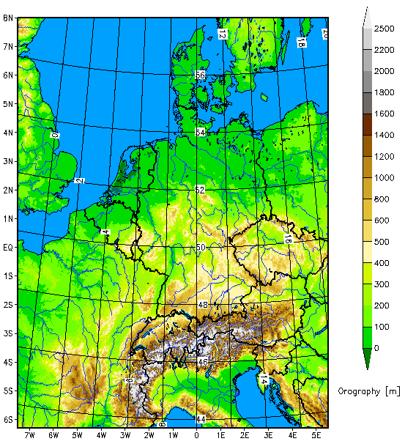
The deterministic NWP-System of DWD
Global-Modell ICON
grid size: 13 km
vertical levels: 90
Grid area: 173 km²
Hybrid DA
13km VarEnKF
Flow dependent B:
B_{VarEnKF} = αB_{LETKF} + (α-1)B_{3DVAR}
Incremental analysis update
SST, SMA and snow ana
ICON-EU Nest over Europe
grid size: 6.5 km
Vertical levels: 60
forecasts:
Grid area: 43 km²
COSMO-DE (convection resolving)
grid size: 2.8 km
vertical levels: 50
forecasts: 3-hourly
Girid area: 8 km²
Det LETKF replace nudging
GODEX Meeting Alexander Cress Lannion 2017

Slide 3
The probabilistic NWP-System of DWD
ICON-EPS; M40
grid size: 40 km
vertical levels: 90
grid area: 1638 km²
Ensemble DA
40 member 40km LETKF.
Horizontal localization radius 300km.
Relaxation to prior perturbations ( 0.75).
Adaptive inflation (0.9 - 1.5).
SST perturbations Soil moisture perturbations (experimental)
COSMO-DE-EPS; M20
grid size: 2.8 km
vertical levels: 50
Forecasts: 3-hourly
grid area: 8 km²
Ensemble DA
40 member 2.8 km LETKF
SST pertubations
Soil moisture pertubations
ICON-EU Nest over Europe
grid size: 20 km
vertical levels: 60
forecasts:
grid area: 407 km²

Slide 4
Satellite data usage
Microwave and infrared instruments
Obs.System | Satellite | Channels | Remarks
AMSU/A | NOAA 15 NOAA 18 NOAA 19 METOP-A/B | 5-14 | RTTOV10 over sea and high peaking channels over clouds and land
AMSU/B MHS | NOAA 19 METOP-A/B | 3-5 | Only over sea
ATMS | NPP | 6-15 | Over sea and high peaking channels over clouds and land
SSIM/S | F-16, F-17, F18 | 4 channels | Monitoring, first experimets end 2017
AMSR-2 | GCOM-W1 | 4 channels | Monitoring, first experimets end 2017
GMI | GPM | 4 channels | Monitoring, first experiments end 2017
SAPHIR | Megha-Tropiques |  | Monitoring
IASI | METOP-A/B | ~50 infrared channels 16 humidity channesl | over sea and high peaking channels over clouds and land
Cris | NPP | ~50 channels | Monitoring and first assimilation experi.
MWTS-2/MWHS-2 | FY-3C |  | Monitoring

Slide 5
Satellite data usage
Microwave and infrared instruments
Obs.System | Satellite | Channels | Remarks
Radioccultation | Cosmic, Grace, Gras, TerraSar, Tandem-X | Upper troposhere and stratosphere | Observation operator; own development
AMV | NOAA13/15, Meteosat 8/10, MTSAT-2, MODIS, NOAA series and Metop, NPP/VIIRS, Himawari-8, Insat-3 FY-2G, COMs | Infrared, visible and wv | Over sea and partly over land. Qi threshold
Scatterometer | ASCAT on Metop-A/B |  | Sea only
Altimetry | Jason-2, Jason-3, Saral | Wind speed | Over sea used since beginning of 2017
Geostationary radiances | Meteosat Seviri | All-sky WV channels | First experiments in regional model

Slide 6
New developments since last meeting
Global scale
Global ICON Ensemble DA system operational Jan. 2016
Global hybrid 3dvar (ENVAR) operational since Jan. 2016
Use of 16 humidity sensitve channels since 2017
Microwave imager radiance data received and monitored
NPP/VIIRS, HIMAWARI-8 and Meteosat 8 AMVs operational
Global Metop A/B pre-operational
Wind speed observations from altimetry (Janson 2/3, Saral)
operational
Radiosondes in Bufr format (including drifting) operational
selected Synop, Ship and Buoys in bufr format
Monitoring of Vaisala RS 41 descenting data
Pre-operational use of GNSS data
Use of sea ice concentration on great lakes operationally

Slide 7
New developments since last meeting
Local scale
LETKF for local model COSMO-DE operational
Use of doppler radar wind data and reflectivities
Use of Meteosat 10 Seviri CSR WV chanels (experimental)
selected radiosonde bufr data operational
selected Synop, Ship and Buoies bufr data operational
Pre-operational use of GNSS (ZTD and STD) data
Pre-operational use of MODE-S data
Aircraft temperature bias correction implemented

Slide 8
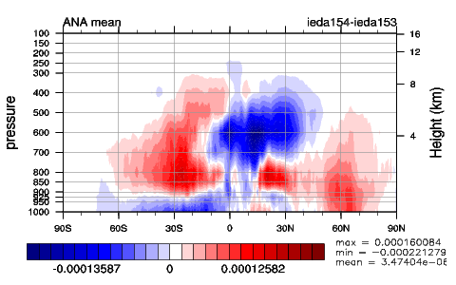
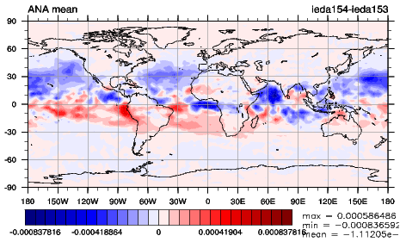
Use of humidity-sensitive IASI
channels
Exp. – Crtl.
Use of 50 temperature-sensitive IASI channels operationally
Use of MHS data operationally
Addional use of 16 humitidy-sensitive IASI channels
Plus reduced thinning (200km -> 120 km) of three MHS channels
Crtl: No use of IASI humidity channels and reduced thinning
One Month in May 2016 / full ensemble
Experiment is drier than Crtl
Experiment is wetter than Crtl

Slide 9
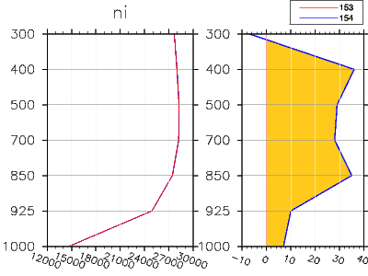
Assimilation cycle Obs minus FG comparison
Radiosonde statistics (globally)
Temporal average: 08.05.2016 - 31.05.2016
Relative Humidity
Crtl
Experiment
Temperatur
Humidity bias slightly increased but error reduced
No systematic change in temperature bias or standard deviation
No of used radisondes slightly increased

Slide 10
Forecast impact
00 UTC forecasts against own analysis - tropics

Slide 11
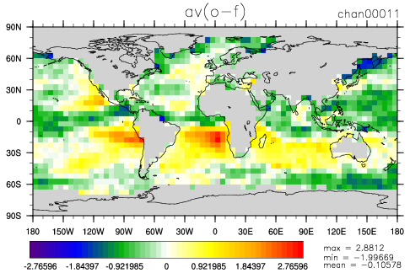
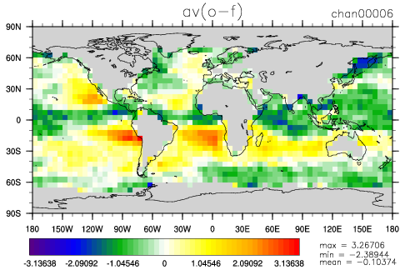
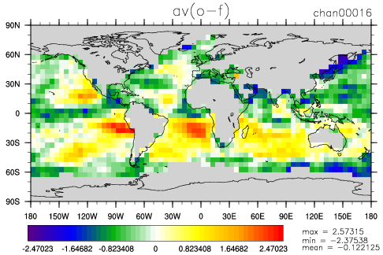
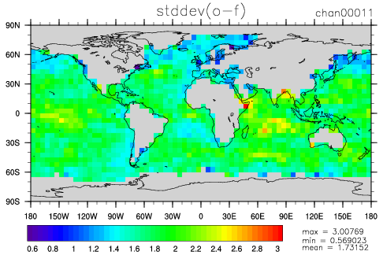
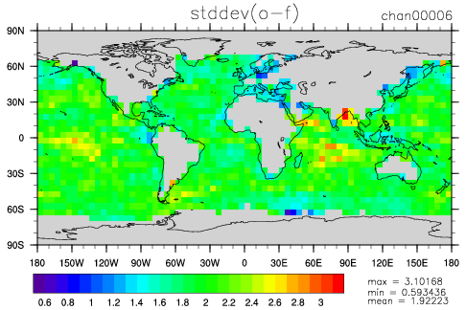
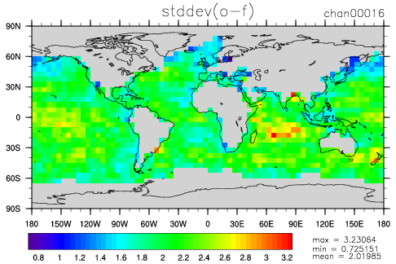
Assimilation of microwave imagers
AMSR2 on GCOM
36.5 GHz V
GMI on GMP
36.5 GHz V
SSMI/S on DMSP-F17
37.0 GHz V
mean (obs – fg)
stddev (obs – fg)
Preparation for assimilating microwave imagers (19 GHz, 24 GHz, 37 GHz, 89 GHz)
in clear sky situations over sea
bias correction and sea ice detection (strong dependence on surface emissivity)
exclusion of scattering situations (cloud detection)
Assimilation experiments planned for autuum/winter 2017

Slide 12
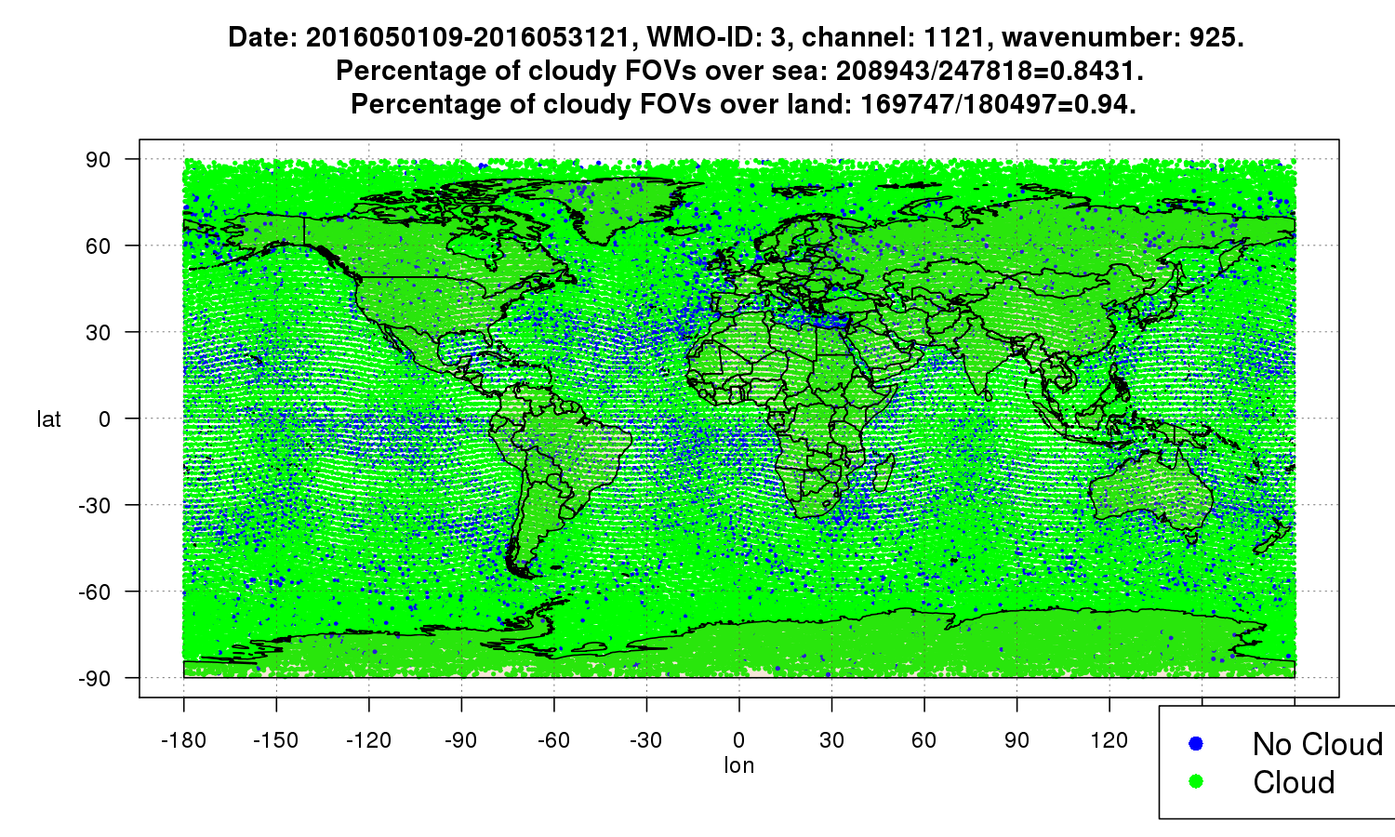
Assimilation of IR radiances over land (Kristin Raykova)
Goal: Assimilation of IR radiances – coming from IASI and CrIS – over land in the window zone (10-14 μm).
Biggest challenges: finding cloud-free FOVs with high confidence and making a reliable estimation of the surface emissivity and skin temperature and their corresponding errors.
Current status: modifying and the operational cloud detection scheme based on McNally and Watts, in order to obtain cloud-free FOVs of low-peaking channels over land with high certainty.
Especially over land ist MNW very conservative
and flags almost all FOVs as cloudy.

Slide 13
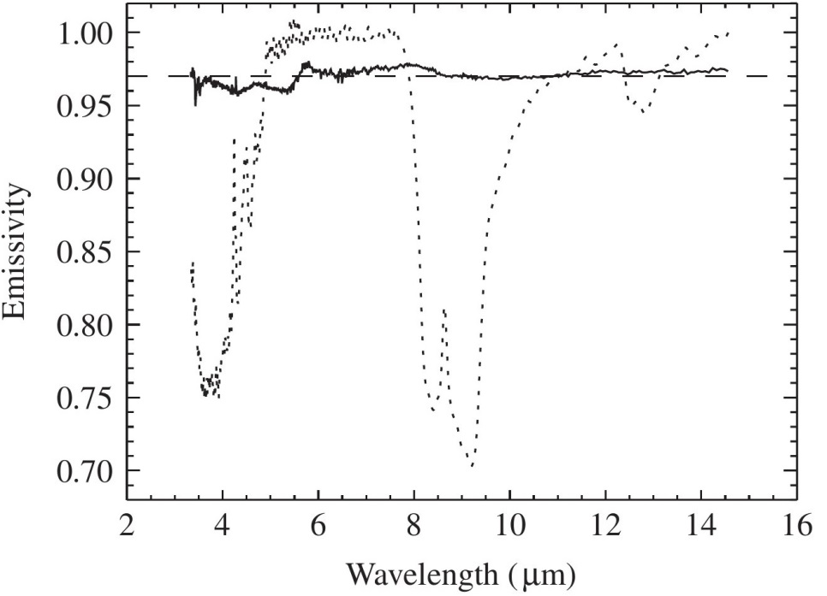
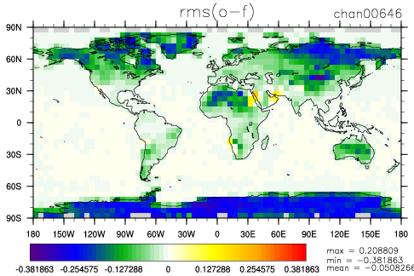
Monitoring of surface emissivity
Brightness temperature of IASI window channel 646 (peak ~ 1 km)
(01.05.2016 – 31.05.2016) Absolute difference of Obs-FG (trial vs. control) Exp. with emissivity atlas – Exp. without atlas (fixed
Value of 0.97)
Oak leaf
Sand sample
Improvement especially over regions with strongly varying emissivity spectrum.

Slide 14
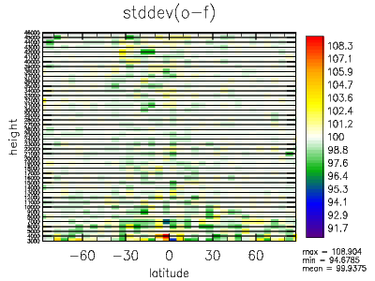
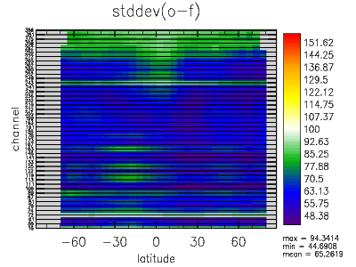
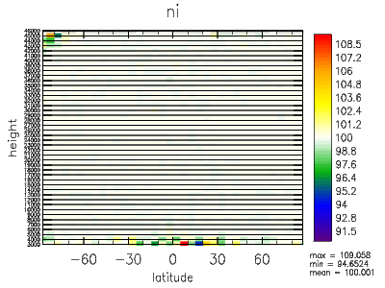
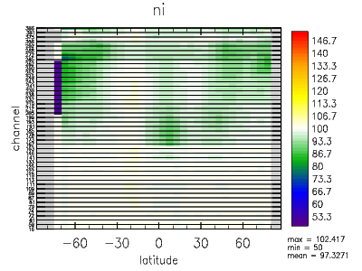
Use of PC compressed
IASI radiances
use of reconstructed radiances (RecRad) based on IASI principal component scores product by EUMETSAT (NWP SAF)
Technical implementation finished, first experiment started
Assimilation of RecRad with ICON-EnVar experiments seems promising regarding to noise reduction under information maintenance (see plots IASI)
Comparison RecRad – Ref (RawRad): neutral or slyightly positive impact on OBS-FG of other observation systems (see plots GPSRO)
Outlook: Routine monitoring of IASI PC datasets from EUMETSAT (NWP SAF)
GPSRO
IASI
contact: silke.may@dwd.de

Slide 15
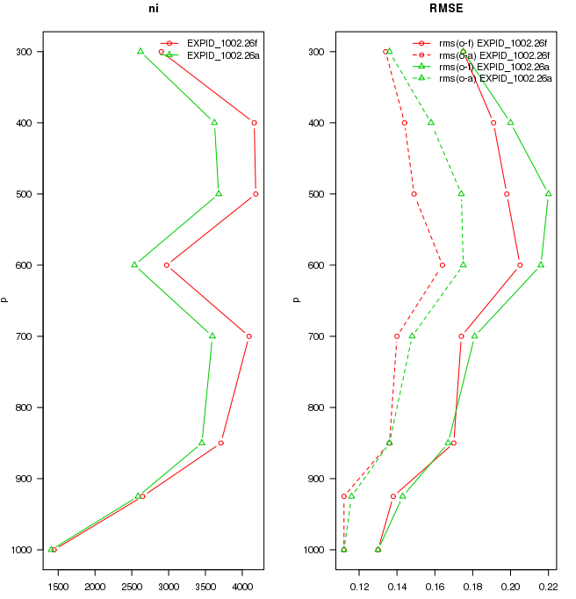
All-sky data assimilation of SEVIRI WV channel data in regional area
Kilometer-scale ensemble data assimilation (KENDA)
Aim : DA taking into account cloudy observations
radiosonde statistics
humidity
Method:
identification of clear and cloudy observations
clear sky : small observation error cloudy: large observation error
First results: improved first guess departure for
clear-sky data
thinning in preprocessing
Assimilation experiments started
number of obs

Slide 16
Use of Atmospheric vector winds
Operational use of HIMAWAR-8 winds
NPP/VIIRS winds became operational
Meteosat 7 AMVs replaced by Meteosat 8 winds operationally
Monitoring of several additional AMVs from
China (FY-2G)
Korea (COMS)
India (INSAT3)
Metosat 11 (Test data set)
new polar Metop winds (three images instead of two)
leo/geo winds from CIMSS
Wind speed dependent bias correction for scatterometer and altimeter
Operational use of Jason 2/3 and Saral altimeter wind speed data
Use CALIPSO cloud heights to derive weekly/monthly correction functions for AMV heights
16/63

Slide 17
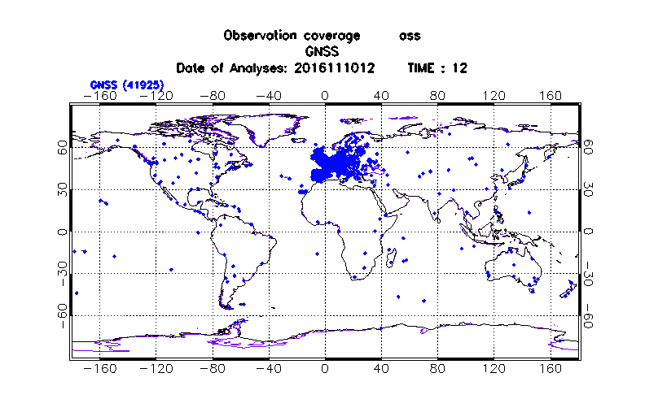
GNSS Zenit/Slant Total Delay (ZTD/STD)
Michael Bender (DWD/IAFE)
GNSS (GPS) Slant Path Delay: humidity integrated over path from ground station to GNSS (GPS) satellite, all weather obs
Many stations => 3D information on humidity, but
STDs are vert. + horiz. non local data (no point measurements). Localisation problematic
Observation Operator works for ZTDs and STDs, globally and regionally (part of COSMO Code)
Single site bias correction developed
Whitelist for processing center selection created
First global (ZTD) and regional (STD) assimilation and forecast experiments started

Slide 18
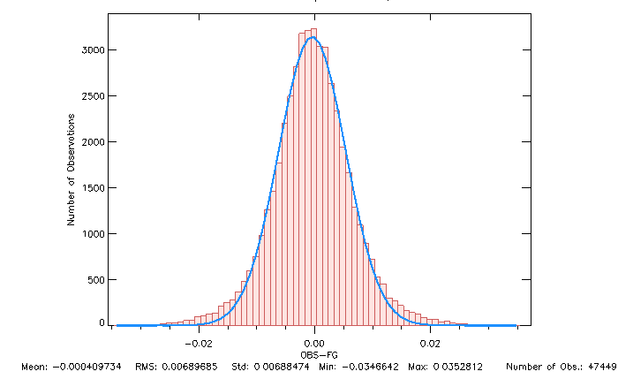
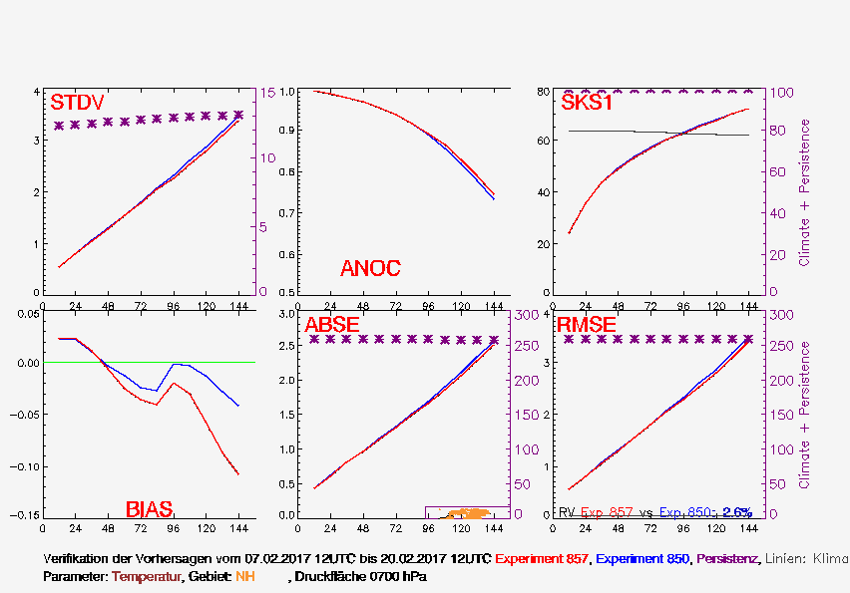
Global ZTD assimilation and
forecast experiment

Slide 19
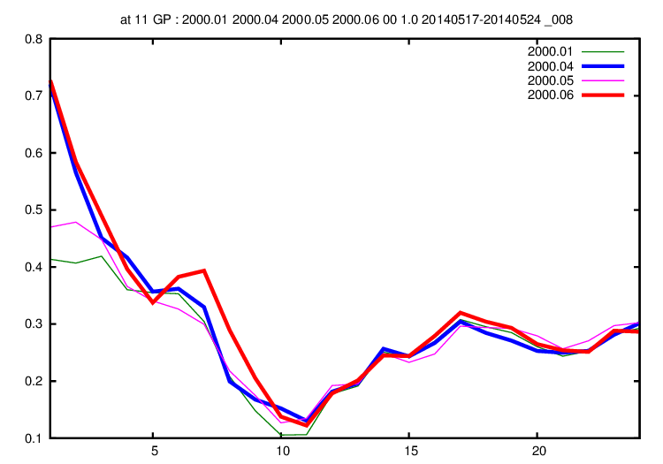
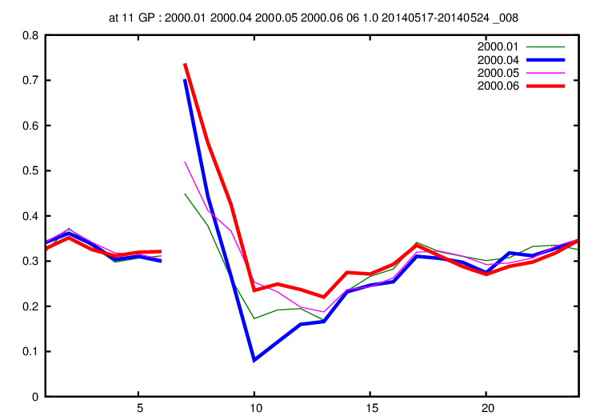
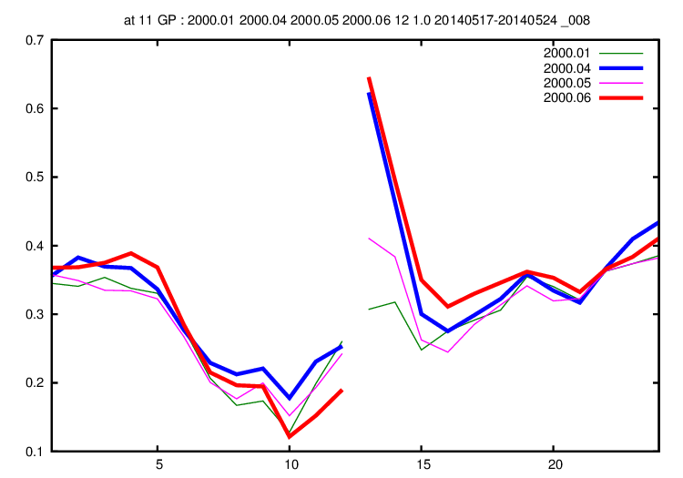
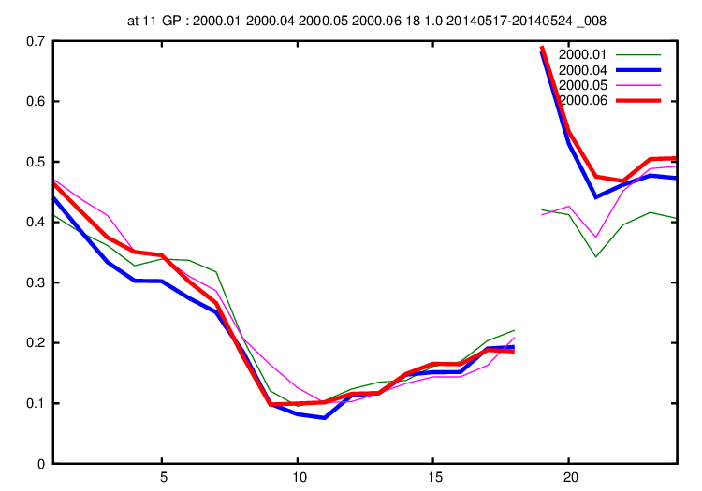
KENDA-O overview, Task 2 (high-res. obs):
GPS-STD, first trial for use in KENDA
8 days
17 – 24 Mai 2014
0-UTC
runs
6-UTC
runs
1-h precip
FSS (30 km)
1 mm/h
CONV only
CONV + GNSS
CONV + LHN = Ref
CONV + LHN + STD
12-UTC
runs
18-UTC
runs
1 mm/h : slightly better for 0-, 6-, 18-UTC runs

Slide 20
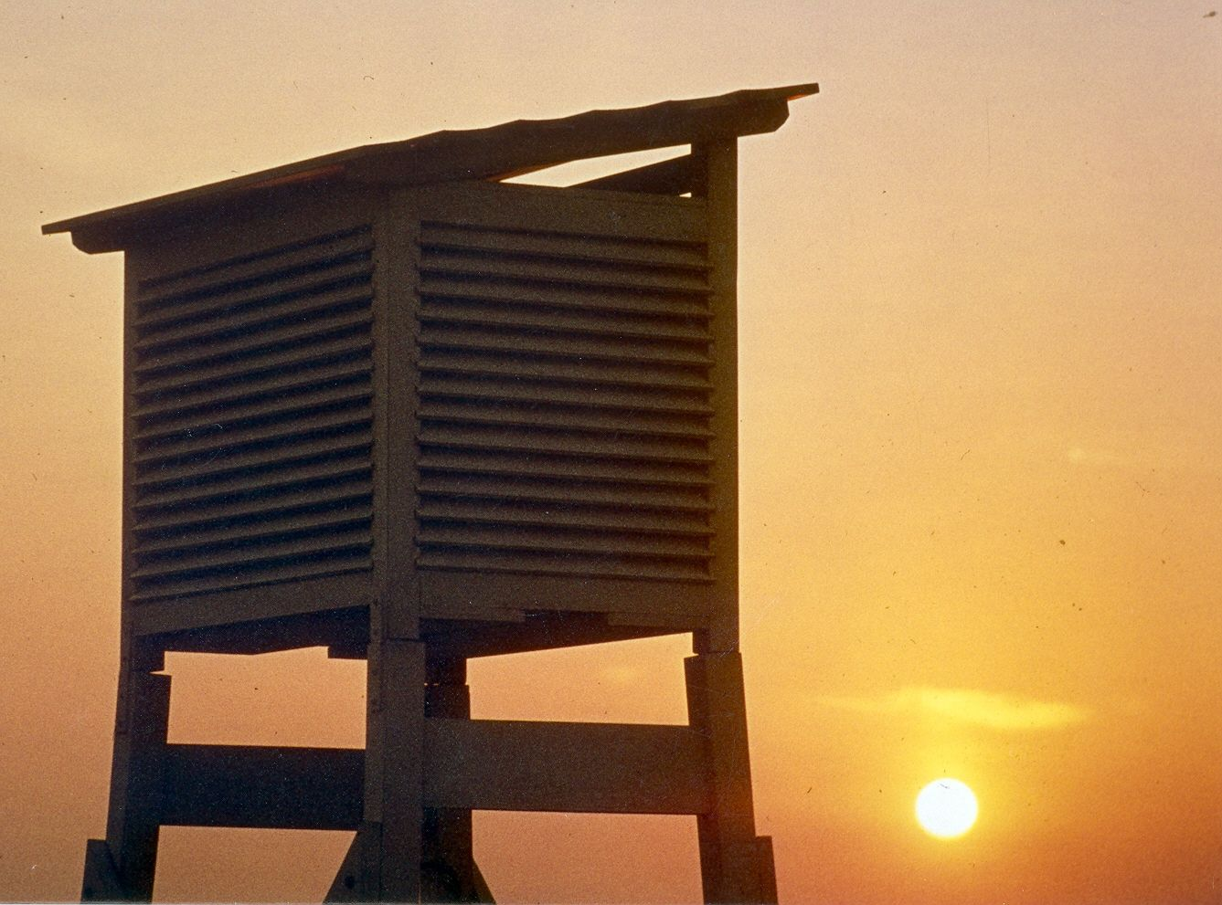
Thank you for your attention! Questions?

